Slide 1
Multi-class Novelty Detection Using Mix-up Technique
──────────────────────────
Author: Supritam Bhattacharjee, Devraj Mandal, Soma Biswas
Indian Institute of Science
Post on: WACV 2020
Reporter: Wei-ting Cao
Date: 2020 / 10 / 12

Slide 2
Outline
─────────────────────────────────────
Introduction
Proposed Method
Experiments
Conclusions
Progress Report

Slide 3
Outline
─────────────────────────────────────
Introduction
Proposed Method
Experiments
Conclusions
Progress Report

Slide 4
Introduction
─────────────────────────────────────
Deep learning approaches have achieved impressive performance for object recognition and classification task by using large networks trained with millions of data examples.
  However, these networks usually work under a closed set assumption, and thus try to classify each query sample, even if it does not belong to one of the training classes.
To make the systems more intelligent and better suited to real-world applications [34] [26], they should be able to understand whether the input belongs to one of the trained classes before trying to classify it.
[26] M. Markou and S. Singh. Novelty detection: a reviewpart 1: statistical approaches. Signal processing, 83(12):2481– 2497, 2003.
[34] M. A. Pimentel, D. A. Clifton, L. Clifton, and L. Tarassenko. A review of novelty detection. Signal Processing, 99:215– 249, 2014.

Slide 5
Introduction
─────────────────────────────────────
This problem is addressed in recent literature as out-of-distribution detection [11], anomaly detection [46], novelty detection [30] [1] and one-class classification [31] [36], each having subtle differences between them.
  One class classification rejects all the classes as outliers except the concerned class.
  Out-of-distribution paradigm, the algorithm determines whether samples are coming from other data-sets or distribution.
[1] D. Abati, A. Porrello, S. Calderara, and R. Cucchiara. Latent space autoregression for novelty detection. In IEEE Conference on Computer Vision and Pattern Recognition (CVPR), pages 481–490, 2019.
[11] T. DeVries and G. W. Taylor. Learning confidence for outof-distribution detection in neural networks. arXiv preprint arXiv:1802.04865, 2018.
[30] R. Mohammadi-Ghazi, Y. M. Marzouk, and O. Buy¨ uk¨ ozt ¨ urk. ¨ Conditional classifiers and boosted conditional gaussian mixture model for novelty detection. Pattern Recognition, 81:601–614, 2018.
[31] P. Perera, R. Nallapati, and B. Xiang. Ocgan: One-class novelty detection using gans with constrained latent representations. In IEEE Conference on Computer Vision and Pattern Recognition (CVPR), pages 2898–2906, 2019.
[36] M. S. Sadooghi and S. E. Khadem. Improving one class support vector machine novelty detection scheme using nonlinear features. Pattern Recognition, 83:14–33, 2018.
[46] B. Zong, Q. Song, M. R. Min, W. Cheng, C. Lumezanu, D. Cho, and H. Chen. Deep autoencoding gaussian mixture model for unsupervised anomaly detection. In International Conference Learning Representations (ICLR), 2018.

Slide 6
Introduction
─────────────────────────────────────
In this work, we address the multi-class novelty detection task [32], where given a query, the goal is to understand whether it belongs to one of the training classes.
  It’s very challenging, since the novel data can come from the same data distribution as that of the training data.
Thus, we propose a novel framework, termed Segregation Network, which utilizes the mix-up technique [42] for this task.
  The goal is to determine the constituent classes and the respective proportions by the interpolated data point.
    Design Constituency loss to train the proposed Segregation Network.
    It can be trained only using the available training data and does not require access to any auxiliary or out-of-distribution dataset as done in similar methods like [32].
[32] P. Perera and V. M. Patel. Deep transfer learning for multiple class novelty detection. In IEEE Conference on Computer 1408 Vision and Pattern Recognition(CVPR), pages 11544–11552, 2019.
[42] Y. Tokozume, Y. Ushiku, and T. Harada. Between-class learning for image classification. In IEEE Conference on Computer Vision and Pattern Recognition (CVPR), pages 5486–5494, 2018.

Slide 7
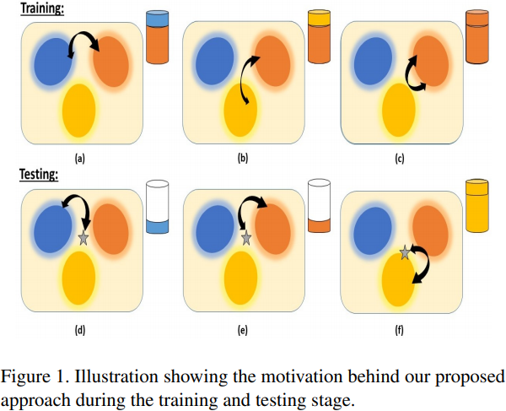
Introduction
─────────────────────────────────────

Slide 8
Outline
─────────────────────────────────────
Introduction
Proposed Method
Experiments
Conclusions
Progress Report

Slide 9


Proposed Method
─────────────────────────────────────
In this section, we describe the network architecture of the proposed Segregation Network (SN), the novel loss function used to train the model and the training and testing protocol.
Notations:
  Input data N being the number of training samples and dt being its feature dimension.
  One-hot labels , where K is the number of training or known classes. the known class set to be C s = {C1, C2, ..., CK and thus

Slide 10
Base Classifier and Features
─────────────────────────────────────
Since the classifier is now required to work in a general setting, the input can come from an unseen class, and thus should not be classified into one of the seen classes.
  Given an input, the novelty detector takes the output features of the base network and decide whether the input belongs to one of the seen classes or to a novel class.
In this work, we use pre-trained AlexNet and VGG16 architecture as the base classifier.
  These networks are fine-tuned on the respective known class datasets and the extracted features are normalized and given as input to our network.

Slide 11
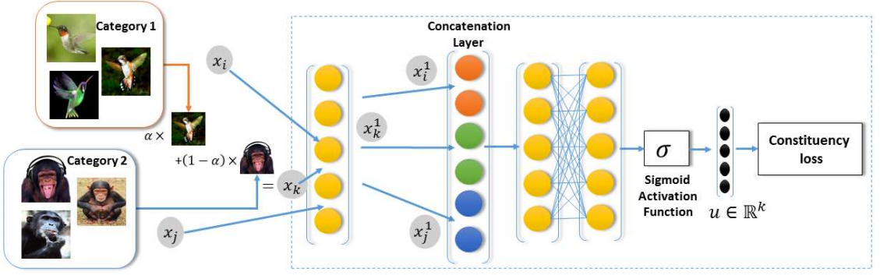
Segregation Network
─────────────────────────────────────

Slide 12

Segregation Network
─────────────────────────────────────
The output of the network is a K dimensional vector from the final Sigmoid layer
  Each element denotes the proportion by which the mixed sample xk has been constructed from that training class.
    For example, an output of [0, 0.6, 0.4, 0, 0] (i.e. there are five known classes) indicates that the mixed sample xk has been constructed as xk = 0.6 xi + 0.4 xj .

Slide 13







Segregation Network
─────────────────────────────────────
Given the following cases may arise,
  If, where p 6= q, and both (Cp, Cq) ∈ C s i.e., belongs to the seen classes set, we should get the output of the model such that, u[p] = α and u[q] = 1 − α, while u[r] = 0 for r 6= {p, q}.
  If, both xi , xj ∈ Cp, Cp ∈ C s the network should ideally output u[p] = 1 and u[r] = 0 for
  During testing in general scenario, we pair the query sample with class prototypes of the known classes, and so a third case may arise if the query belongs to a novel class.
    We do not explicitly train the network for this scenario, since we do not assume any auxiliary dataset.

Slide 14
Segregation Network
─────────────────────────────────────
Note that as the final activation function is the Sigmoid layer and not the standard softmax, total sum of u may not be equal to 1.
  If the input belongs to a novel class, the network will only consider the mixing proportion of the known class.
    So the proportion of unknown class in the mixture will be ignored and thus the sum will not be equal to 1.

Slide 15

Segregation Network
─────────────────────────────────────
Our network needs to be trained in such a way that the value of u peaks at the position of the constituent classes and also gives the proper mixing proportions.
  Since, we do not have the softmax output, we cannot use cross-entropy loss function to train this model.
Hence, We design a novel loss function termed as Constituency loss (L cons) to train our model.
m: mixing class set, nm: non-mixing class set
β: the mixing coefficient vector.

Slide 16
Testing Scenario
─────────────────────────────────────
In the general testing scenario, the test query can come from one of the seen classes or from a novel class.
  Given a test query, we consider the Top-N classes which get the highest output scores from the classifier.
The goal of the Segregation Network is to consider each of these top classes, and verify whether the query actually belongs to one of those classes.

Slide 17


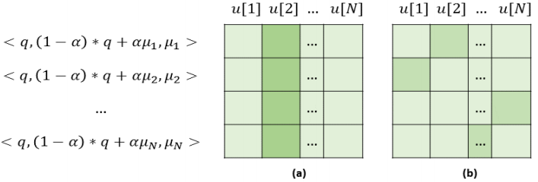
Testing Scenario
─────────────────────────────────────
Here we use training class centers, µr where r ∈ {1, 2, 3, .., N}, where (N < K) as the prototype exemplars.
  For each query, q, a set of interpolated points is generated as {q, µr , xr}, where .
  The prediction using all exemplar points {µr} N can be viewed as a square matrix whose each row signifies the prediction values when paired with a particular cluster center.

Slide 18
Testing Scenario
─────────────────────────────────────
The mixing coefficient for the prototype exemplars is kept low while feeding to the model. This is because of the following reasons:
  If the query data belongs to one of the known classes, the high (1 − α) value for the query example would produce a high u[r] value for the correct known class as shown in Figure 3 (a).
  If the query data belongs to an unknown class, the low α value used for the prototype exemplars forces the u[r] to be low for all the known classes as shown in Figure 3 (b).
We define the membership score as the average of the maximum score in each row.

Slide 19
Outline
─────────────────────────────────────
Introduction
Proposed Method
Experiments
Conclusions
Progress Report

Slide 20
Datasets Used and Testing Protocol
─────────────────────────────────────
Benchmark datasets
  Caltech 256 dataset [16]
    A standard dataset for visual recognition consisting of objects spread over 256 diverse categories.
    30607 images (minimum of 81 to maximum of 827 images per class).
    Took the first 128 classes as known and rest as unknown.
  Stanford Dogs dataset [19]
    A fine grained dataset which has been curated from the ImageNet dataset and consists of images of different breeds of dogs of 120 categories.
    20580 images.
    Consider the first 60 classes, sorted alphabetically as known.
[16] G. Griffin, A. Holub, and P. Perona. Caltech-256 object category dataset. Technical Report 7694, California Institute of Technology, 2007.
[19] A. Khosla, N. Jayadevaprakash, B. Yao, and F.-F. Li. Novel dataset for fine-grained image categorization: Stanford dogs. In CVPR Workshop on Fine-Grained Visual Categorization (FGVC), volume 2, 2011.

Slide 21
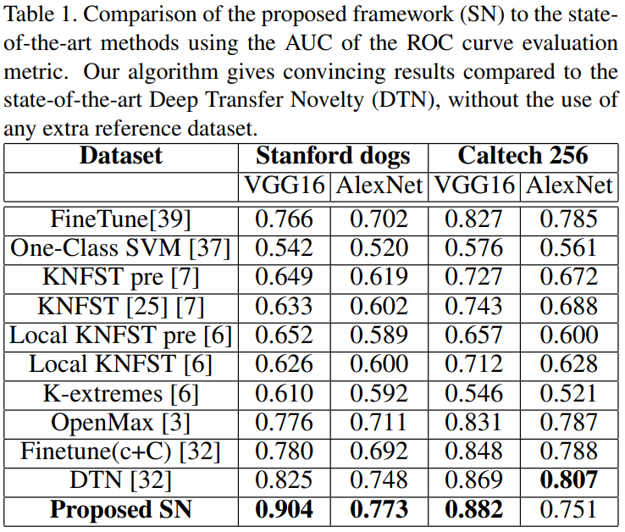
Experimental Results
─────────────────────────────────────

Slide 22
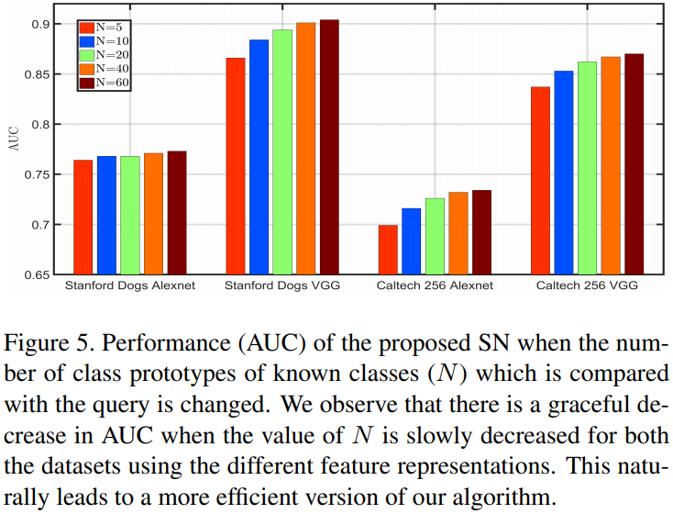
Analysis and Observation
─────────────────────────────────────
Effect of number of top classes used for novelty computation

Slide 23
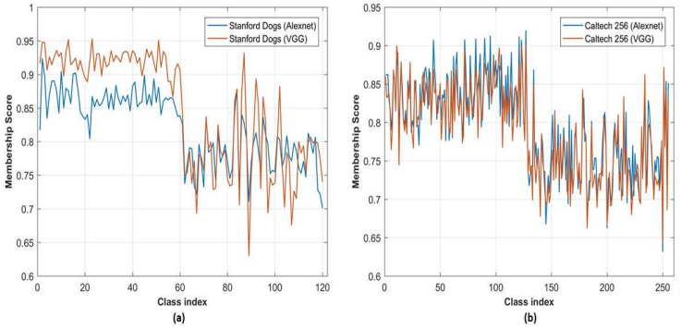
Analysis and Observation
─────────────────────────────────────
Analysis of class-wise membership score

Slide 24
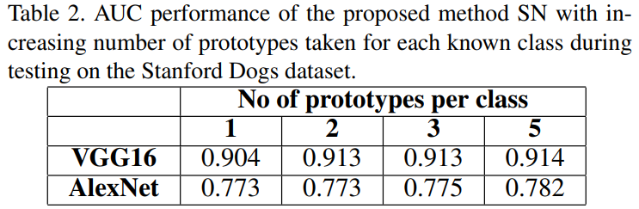
Analysis and Observation
─────────────────────────────────────
Varying the number of prototypes per class
  We have used the mean vector as the class prototype for each class in all our experiments.
    applying k-means algorithm on each category and then selecting the subsequent cluster centers which have been formed.

Slide 25
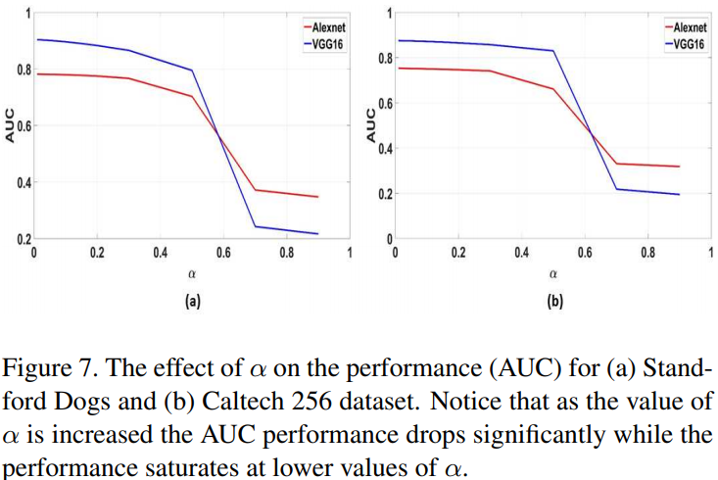
Analysis and Observation
─────────────────────────────────────
Effect of mixing coefficient α

Slide 26
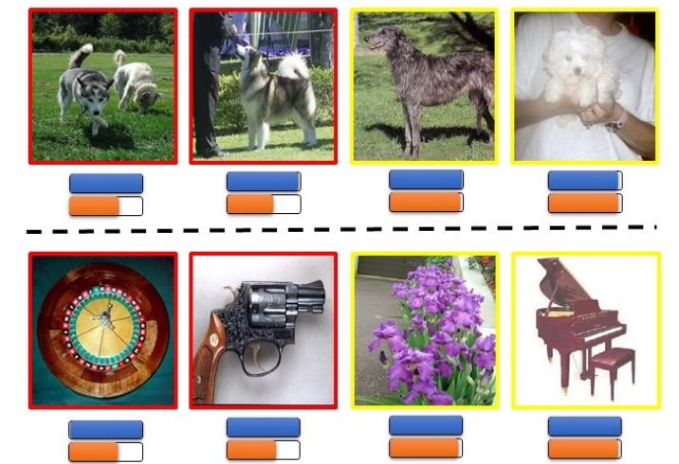
Analysis and Observation
─────────────────────────────────────
Softmax vs Membership Scores

Slide 27
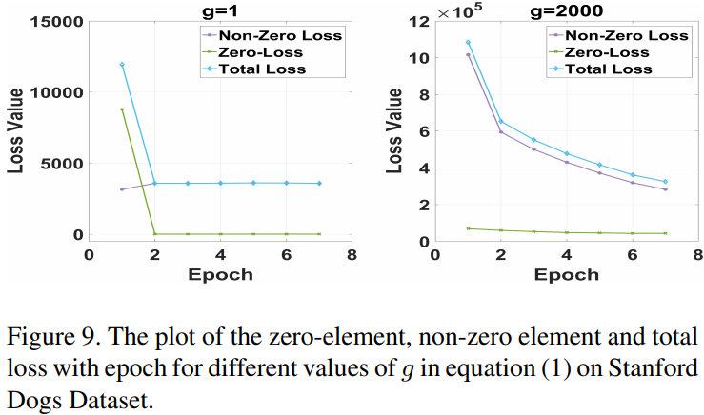
Analysis and Observation
─────────────────────────────────────
Effect of loss weighting factor g

Slide 28
Outline
─────────────────────────────────────
Introduction
Proposed Method
Experiments
Conclusions
Progress Report

Slide 29
Conclusions
─────────────────────────────────────
Developed a novel framework for multi-class novelty detection which works using the concept of mix-up technique.
  Without having access to any extra auxiliary dataset.
Designed a novel constituency loss for training the proposed model.
Developed an efficient version of our algorithm, without any significant drop in performance, which utilizes the softmax confidence outputs of the pre-trained network.

Slide 30
Outline
─────────────────────────────────────
Introduction
Proposed Method
Experiments
Conclusions
Progress Report

Slide 31
Progress report
─────────────────────────────────────
Multi-class Novelty Detection (MND)
  訓練資料來自多種類別的 data，且將剩於的類別當作 novelty class。
  目前應用於 stanford dog dataset.
    總共 120 種狗狗，共 20580 張影像。
    前面 60 種狗隨機取一半作為訓練集、另一半為測試集；剩下的種類也作為測試集。
      其中 known data 和 novelty data 的比例為 1 : 1。

Slide 32

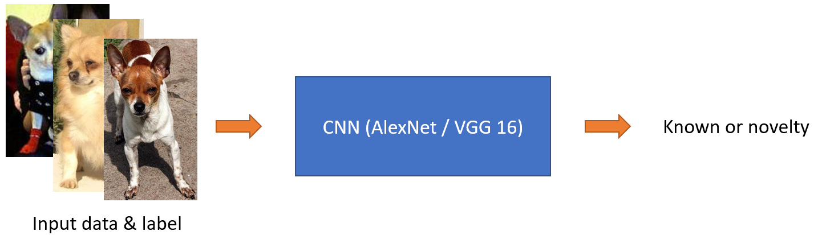
Progress report
─────────────────────────────────────
以論文中 finetune 的架構當作 baseline。
  Based architecture (AlexNet / VGG16)
    用 dog dataset 來 finetune 預訓練好的 model

Slide 33
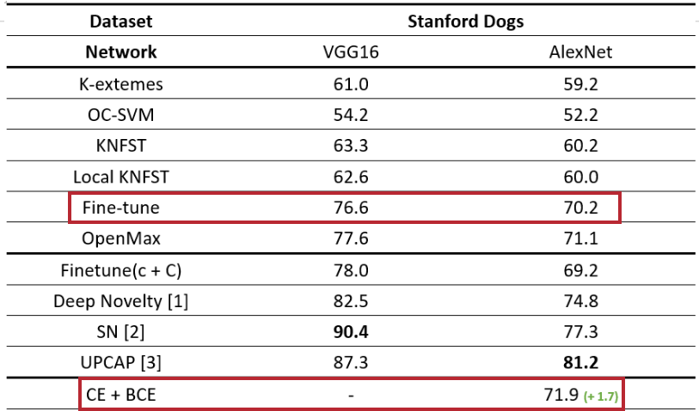
Progress report
─────────────────────────────────────
其中 based architecture 使用 cross entropy 來進行優化。
  Activate function 使用 softmax function (不適用於 MND) (based version)
因此 activate function 改用 sigmoid function 且用 binary cross entropy 來進行優化。

Slide 34


Progress report
─────────────────────────────────────
Proposal 1
  將 CNN 倒數第二層取出的 feature vector (4096 維) 進行內插：
    同 class 的 feature 內插後，應屬同一個 class。
    不同類的 feature 內插後，應屬 novelty class。
  給定 xi 和對應的 class yi、同 class 的 和不同 class 的 .

Slide 35
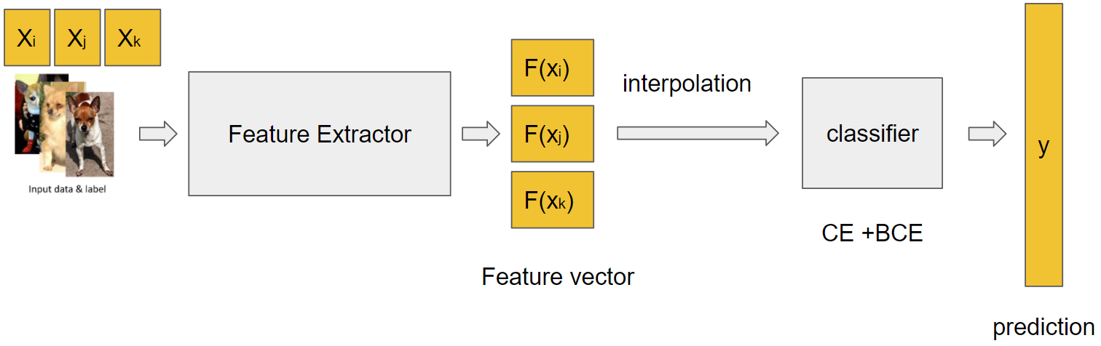
Progress report
─────────────────────────────────────
Framework

Slide 36
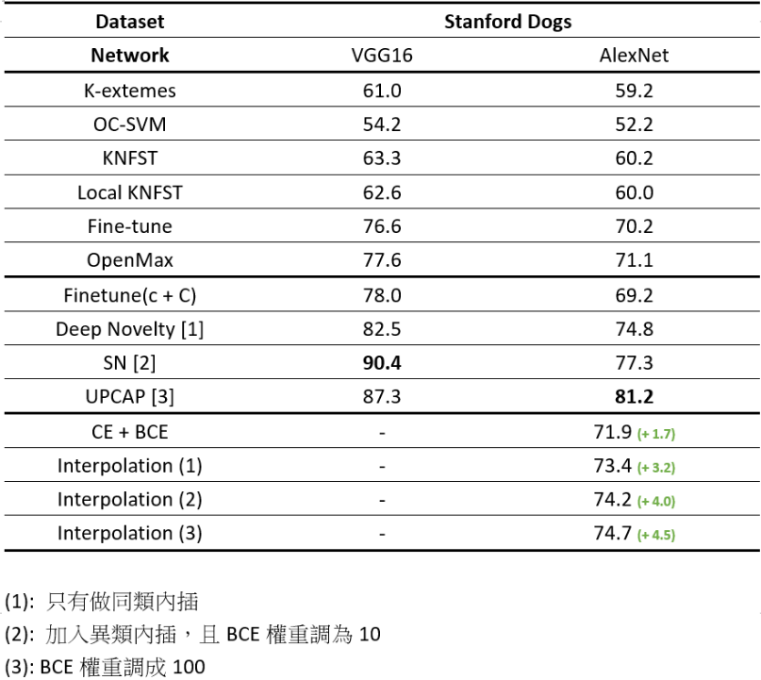
Progress report
─────────────────────────────────────
[1] Deep Transfer Learning for Multiple Class Novelty Detection. Pramuditha Perera, Vishal M. Patel. CVPR 2019.
[2] Multi-class Novelty Detection Using Mix-up Technique. Supritam Bhattacharjee, Devraj Mandal, Soma Biswas. WACV 2020.
[3] Utilizing Patch-level Category Activation Patterns for Multiple Class Novelty Detection. Poojan Oza, Vishal M. Patel. ECCV 2020.

Slide 37
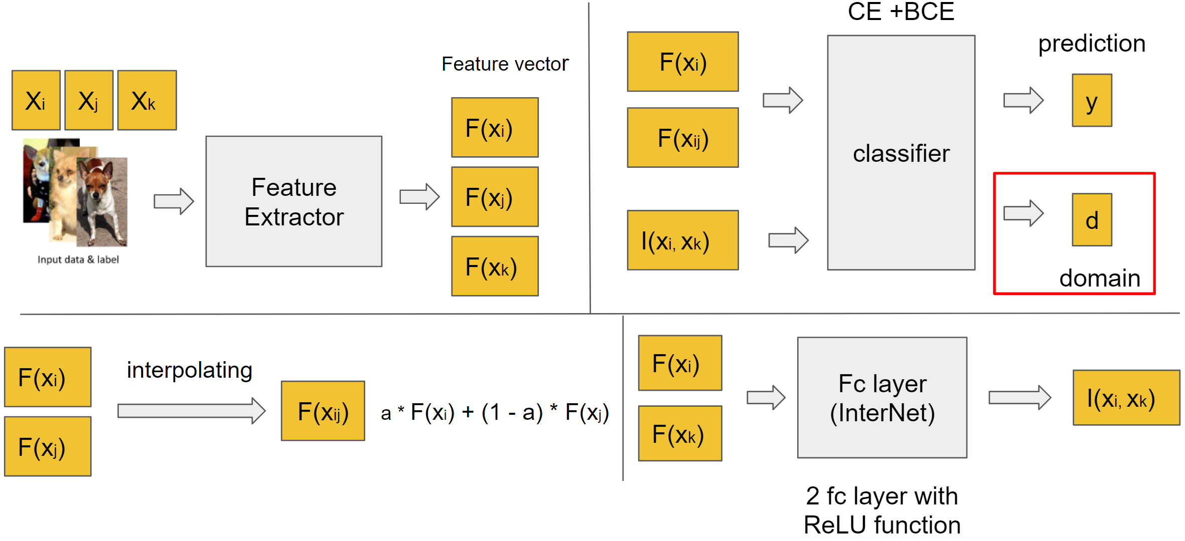
Progress report
─────────────────────────────────────
Proposal 1.1

Slide 38
Progress report
─────────────────────────────────────
InterNet 必須盡可能的生成越像 known sample (F(xi)) 的 novelty feature 越好、且能騙過 classifier；而 classifier 必須要能夠判別 InterNet 輸出的 feature 為 novelty feature，且同時判別 feature 來自於哪裡。
藉由對抗式的學習，讓 classifier 提升判別 novelty feature 的能力。

Slide 39
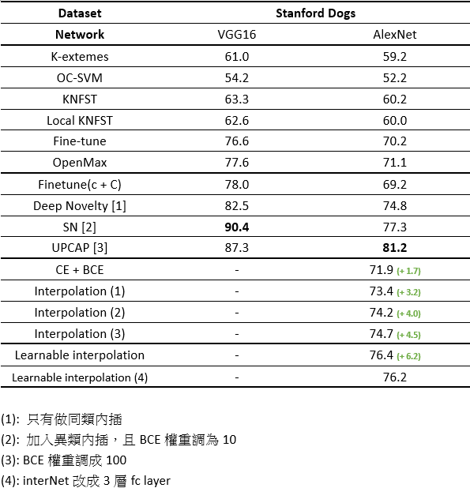
Progress report
─────────────────────────────────────

Slide 40
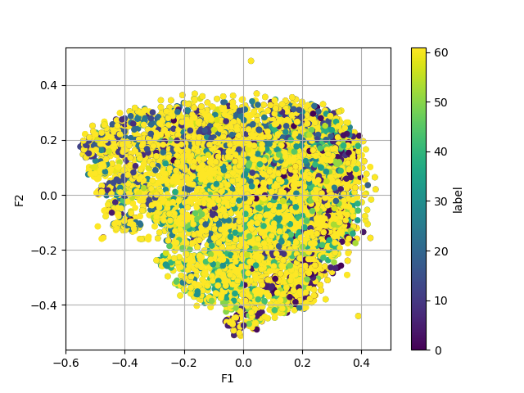
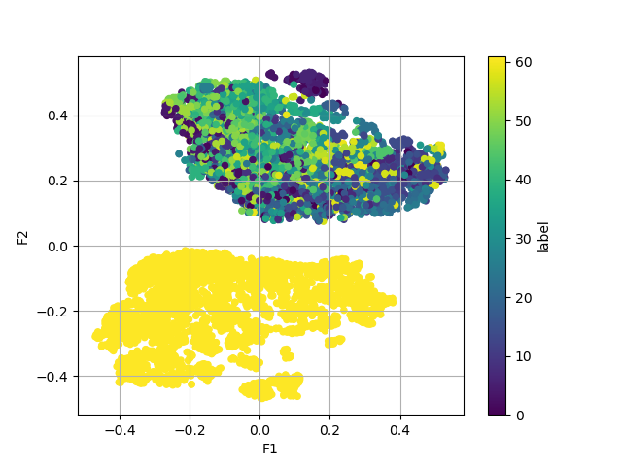
T-sne visualization
─────────────────────────────────────

Slide 41
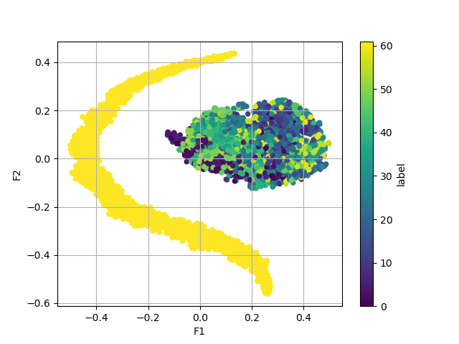
Progress report
─────────────────────────────────────
Proposal 1.2
  在 InterNet 的 loss function加上 cosine similarity loss，讓生成的 feature 能更靠近 known class 的分布。

Slide 42
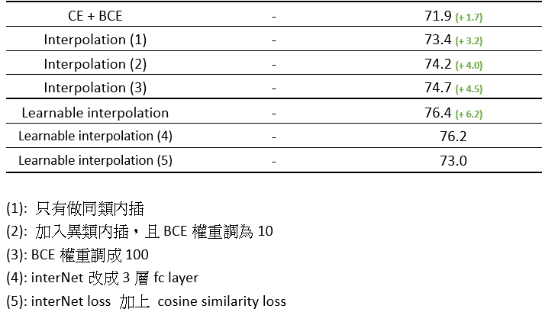
Progress report
─────────────────────────────────────

Slide 43
Progress report
─────────────────────────────────────
Proposal 2.0
  結合線性內插和 learnable interpolation 的方式來訓練模型。
  去除 domain adversarial loss

Slide 44
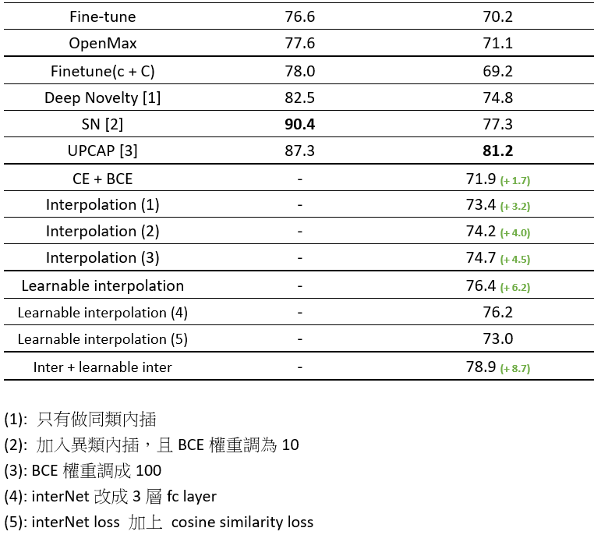
Progress report
─────────────────────────────────────

